Slide 1
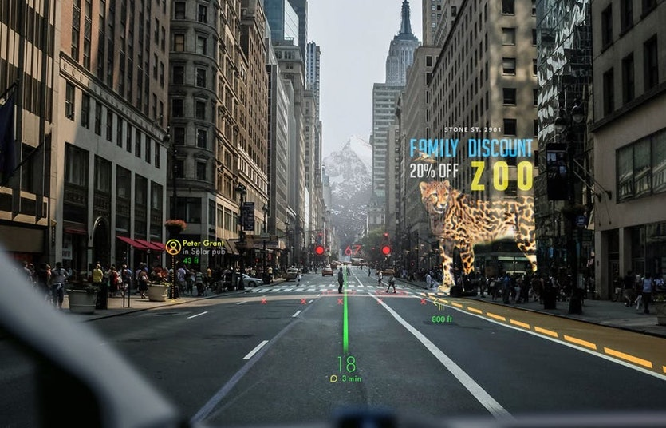
Lane Detection in Self Driving Cars
Presented by
Jyothi Raju
11612830

Slide 2
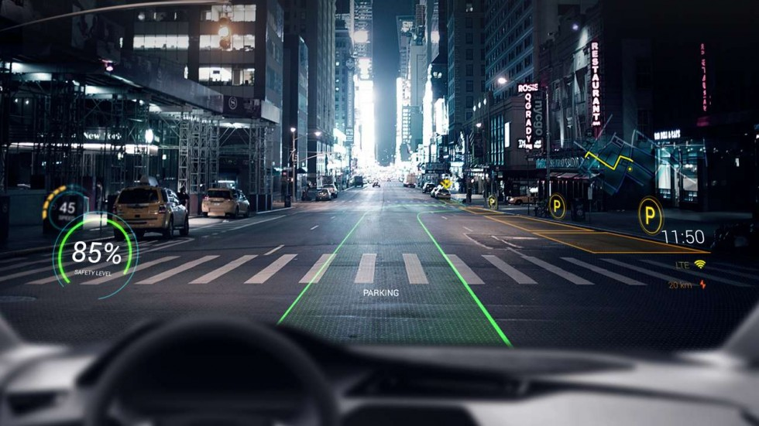
What is Lane Detection?
Lane detection is a well-researched area of computer vision with applications in autonomous vehicles and driver support systems. This is in part because, car analysis white or yellow lane on the road to keep vehicle on the road in a correct direction.

Slide 3
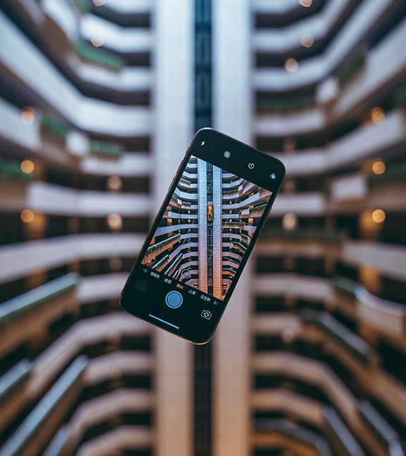
Difference between computer vision and image processing
The main difference is in goals, not in methods. For example, if the goal is to enhance image for later use , then this may be called image processing. And if the goal is to emulate human vision like object recognition, defect detection or automatic driving, then it is closer to computer vision
.

Slide 4
Success of Lane Detection in Self Driving Car
Self Driving Cars
It is a vehicle that is capable of sensing its environment and navigating without human input.
Autonomous cars combine a variety of techniques to perceive their surroundings including radar , laser light , GPS, odometry, lane detection and Computer Vision
Advanced control systems interpret sensory information to identify appropriate navigation paths, as well as obstacles and relevant signage

Slide 5
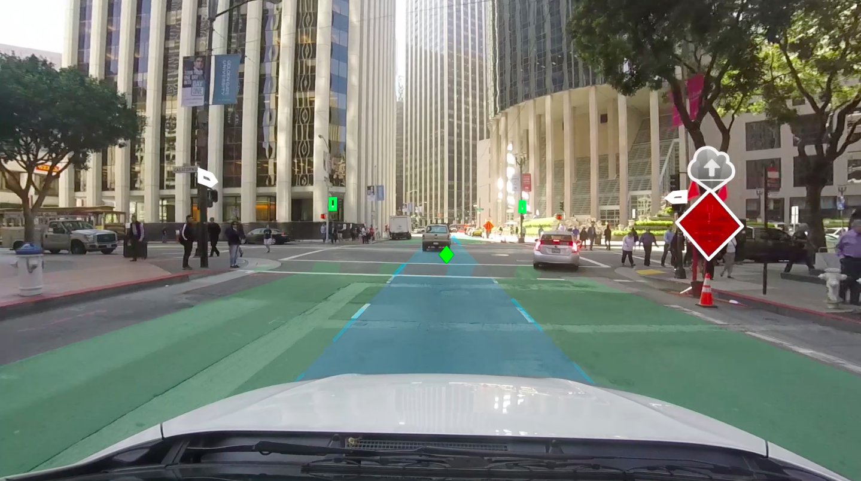
Methods used to Develop lane detection
Gray scale
Gaussian smoothing
Canny edge detection
Region of interest
Hough space
Create two averaged lines across frames for a smooth video playback
Draw lines

Slide 6
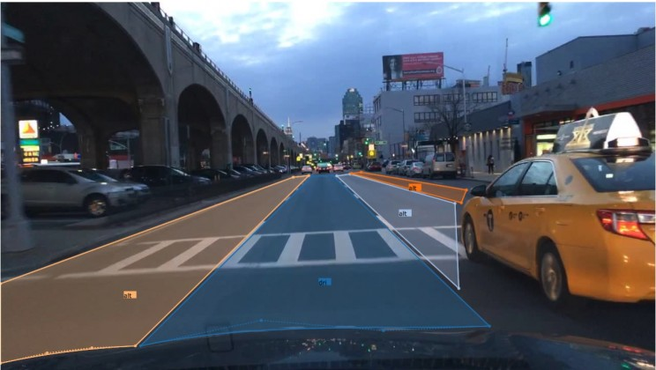
Lets see how the stimulation works

Slide 7
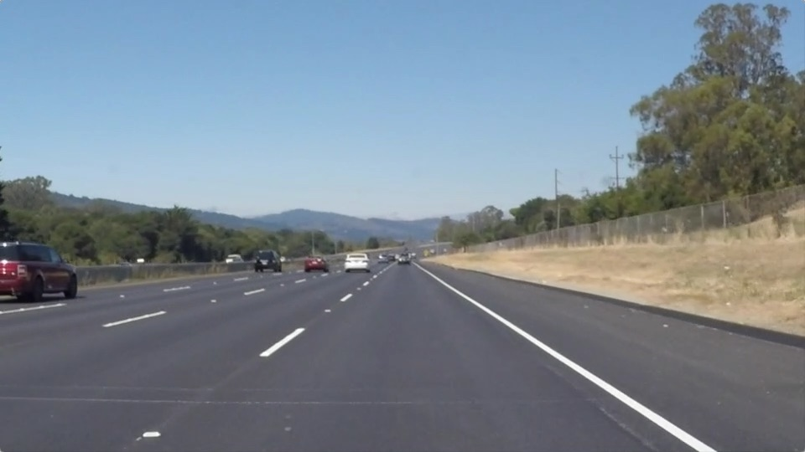
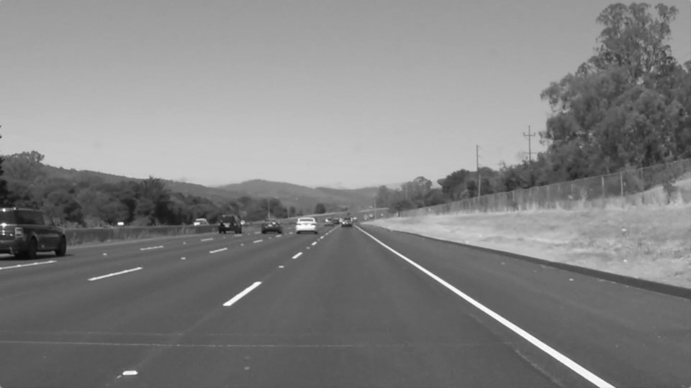
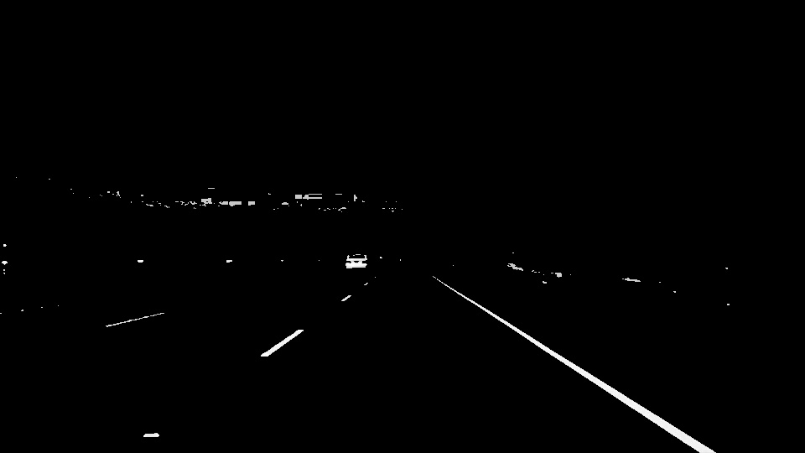
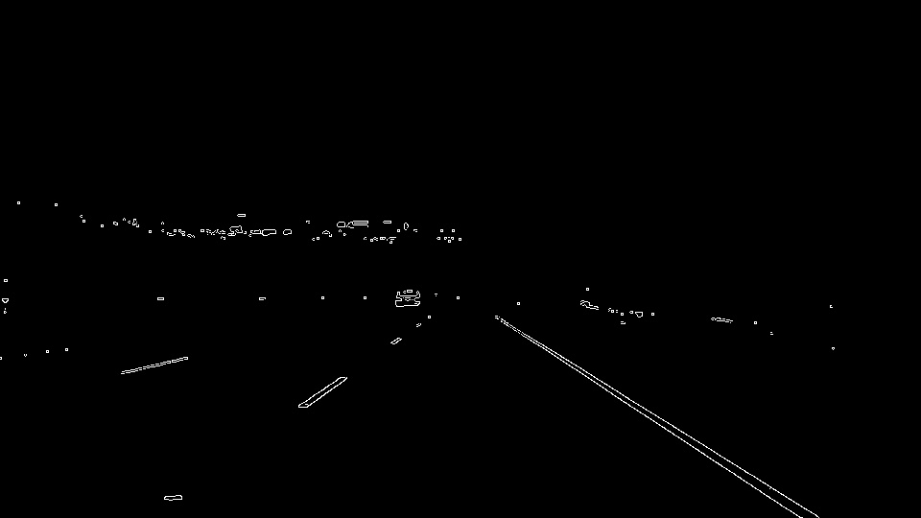
Original Pic
Grey scale
Smoothing
Canny

Slide 8
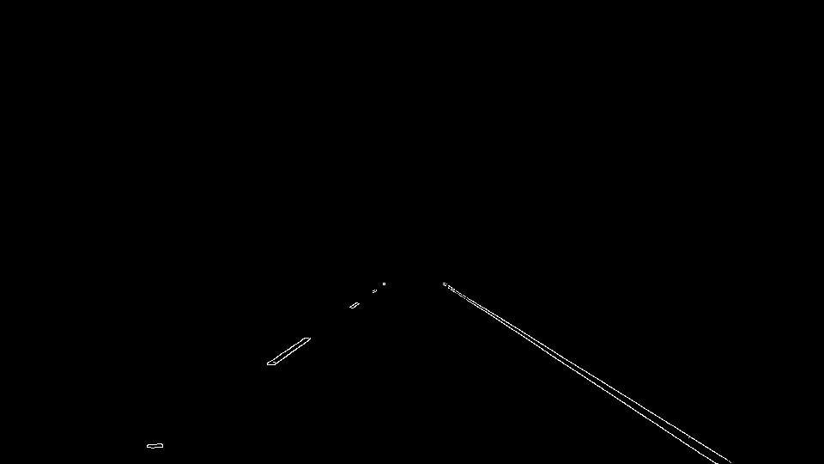
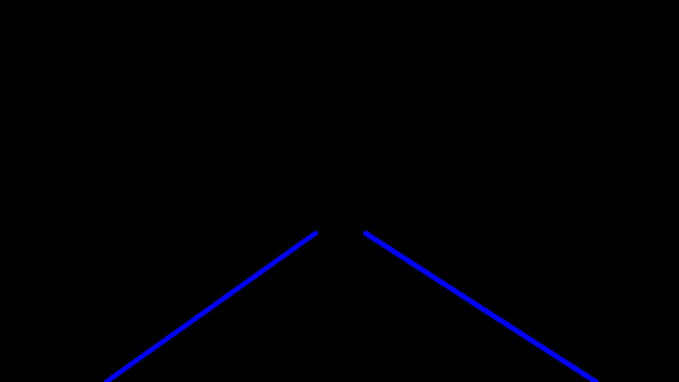
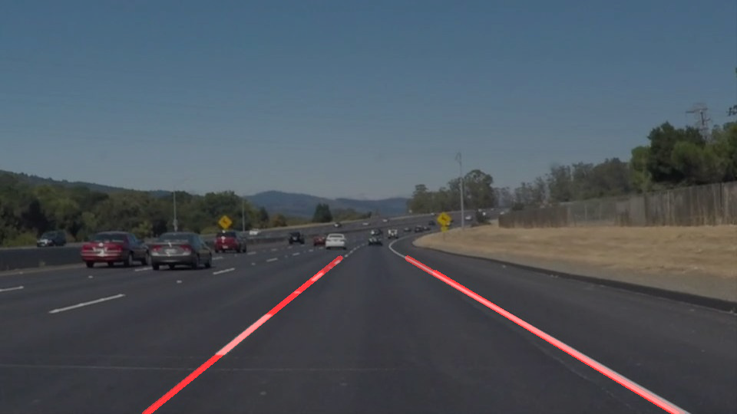

ROC
Hough Space
Final Result
Averaged lines

Slide 9
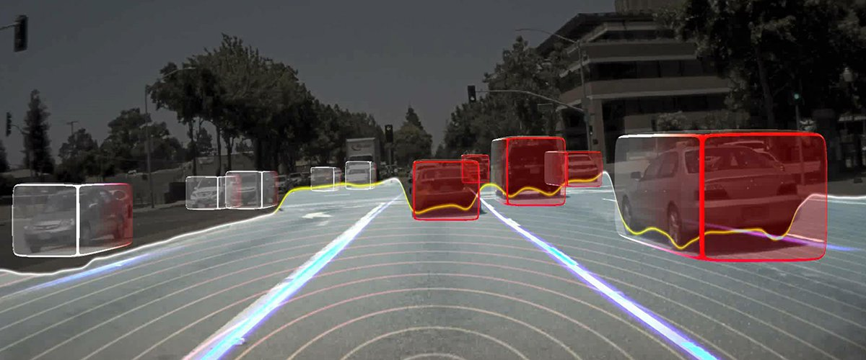
This How Autonomous Cars Sees The World

Slide 10
Classical VS Deep
Classical Learning
Deep learning
Less Rate of Accuracy
Computationally Cheaper
Can be Easier to Interpret
Less Faster Than Deep learning
Eg : SVM(Support Vector Machine) .etc
Great Accuracy
More Computational Expensive
Data Hungry
Faster Than Classical Learning With High Gpu
Eg : R-CNN , CNN , Faster R-CNN , YOLO ..etc.

Slide 11
Applications
Lane Detection is used in Self Driving Cars
Lane Detection is also used to find the Curvature of the Road
Lane Departure warning system in maned Vehicles
Lane Detection is used to Find Left Curvature , Right Curvature, Centre Alignment

Slide 12
Large Picture Slide
Within 20 years, computer vision will be a commodity component within the fabric of the worldwide analytics infrastructure, similar to the telecommunications infrastructure of today, containing distributed analytics and databases services. A few new Neural Computing (NC) architectures will be standardized in silicon, applicable to all forms of data.
Future Of Computer Vision in Self Driving Cars

Slide 13
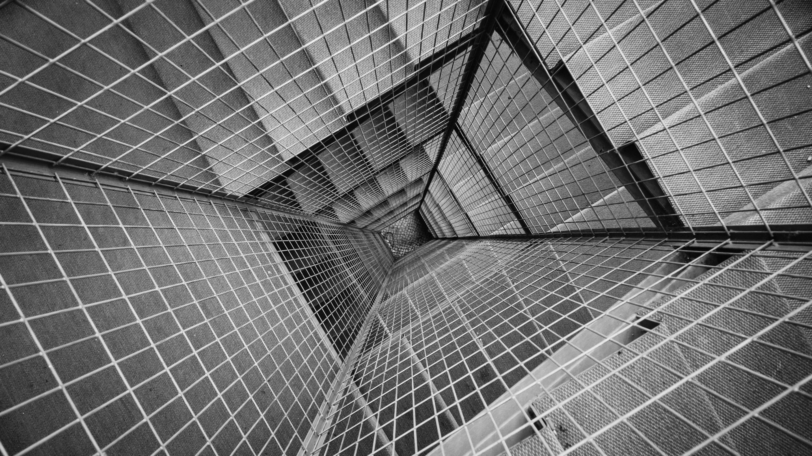



THANK YOU
Jyothi Raju
7986057623
jyothiraju0384@gmail.com

